Slide 1
Decision Tree Algorithm
Decision Tree Algorithm:
A Decision Tree is a supervised machine learning algorithm used for both classification and regression tasks. It works by recursively partitioning the dataset into subsets based on the values of input features. The goal is to create a tree-like structure where each internal node represents a decision based on a feature, each branch represents the outcome of that decision, and each leaf node represents the final predicted outcome.
Key Steps in the Decision Tree Algorithm:
Attribute Selection: Choose the best attribute to split the data based on some criteria. Common criteria include Information Gain, Gini Impurity, or Mean Squared Error.
Splitting: Divide the dataset into subsets based on the chosen attribute. Each subset corresponds to a unique value of the chosen attribute.
Recursive Building: Recursively apply the above steps to each subset until a stopping criterion is met. This criterion could be a maximum depth limit, a minimum number of samples in a leaf, or other conditions.
Leaf Node Assignment: When a stopping criterion is met, assign a class label (for classification) or a predicted value (for regression) to the leaf nodes.

Slide 2
Attribute Selection Measures:
Different algorithms use various measures to decide the best attribute for splitting. Some common measures include:
Information Gain: Measures the reduction in entropy or impurity after a dataset is split.
Gini Impurity: Measures the probability of incorrectly classifying a randomly chosen element in the dataset.
Mean Squared Error (MSE): Used in regression tasks, it measures the average squared difference between the actual and predicted values.
Advantages of Decision Trees:
Interpretability: Decision trees are easy to understand and interpret, making them suitable for explaining complex decision-making processes.
Handling Non-Linearity: They can capture non-linear relationships in the data without the need for complex mathematical transformations.
Variable Importance: Decision trees provide a feature importance score, indicating the relevance of each feature in making predictions.

Slide 3
Disadvantages of Decision Trees:
Overfitting: Decision trees are prone to overfitting, capturing noise in the training data and performing poorly on unseen data.
Instability: Small changes in the data can lead to different tree structures, making decision trees less stable.
Biased Toward Dominant Classes: In classification tasks with imbalanced class distributions, decision trees can be biased toward the dominant class.
Ensemble Methods:
Decision Trees are often used in ensemble methods like Random Forests and Gradient Boosting to improve overall predictive performance and mitigate the weaknesses of individual trees.
Attribute Selection Measures used by ID3 Algorithm:
ID3 (Iterative Dichotomiser 3) is one of the earliest decision tree algorithms. It uses the concept of entropy and information gain to determine the attribute to split on. Here are the attribute selection measures used by the ID3 algorithm:

Slide 4
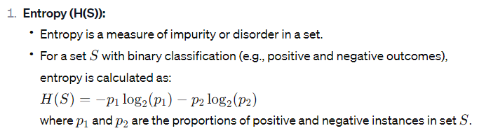
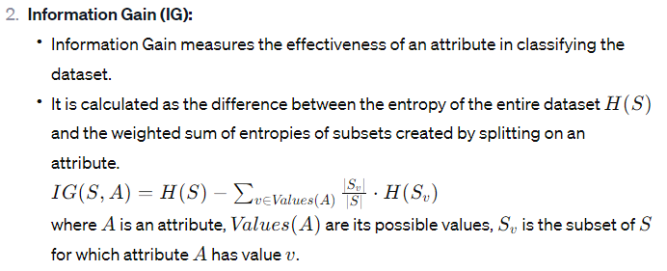

Slide 5
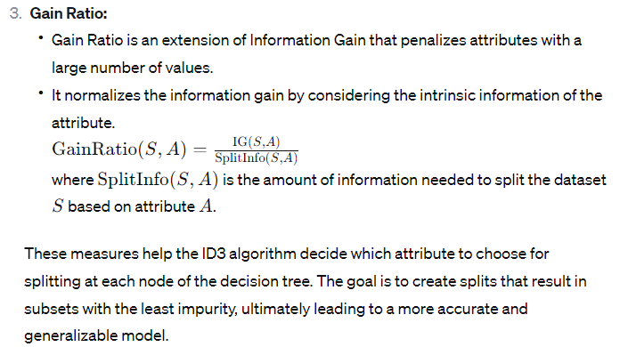

Slide 6
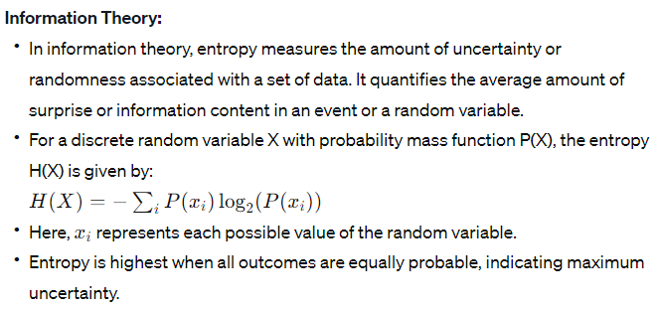
Entropy
Definition: Entropy is a concept used in various fields, including information theory, and statistics, with slightly different interpretations in each context.

Slide 7
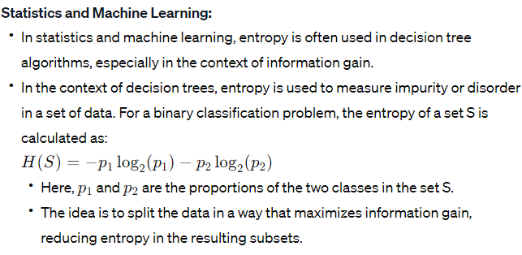

Slide 8
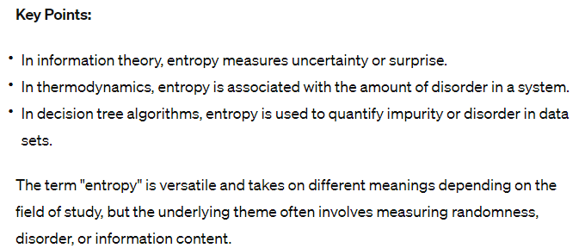

Slide 9
Example: ID3 Algorithm
Day | Weather | Temp | Humidity | Wind | Play Tennis
Day 1 | Sunny | Hot | High | Weak | No
Day 2 | Sunny | Hot | High | Strong | No
Day 3 | Overcast | Hot | High | Weak | Yes
Day 4 | Rain | Mild | High | Weak | Yes
Day 5 | Rain | Cool | Normal | Weak | Yes
Day 6 | Rain | Cool | Normal | Strong | No
Day 7 | Overcast | Cool | Normal | Strong | Yes
Day 8 | Sunny | Mild | High | Weak | No
Day 9 | Sunny | Cool | Normal | Weak | Yes
Day 10 | Rain | Mild | Normal | Weak | Yes
Day 11 | Sunny | Mild | Normal | Strong | Yes
Day 12 | Overcast | Mild | High | Strong | Yes
Day 13 | Overcast | Hot | Normal | Weak | Yes
Day 14 | Rain | Mild | High | Strong | No

Slide 10
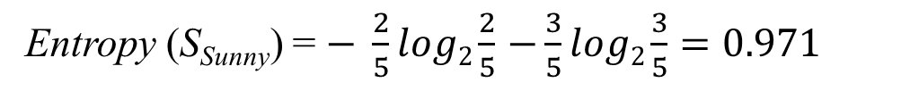
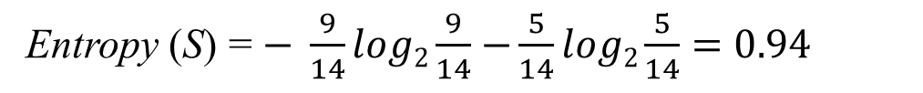
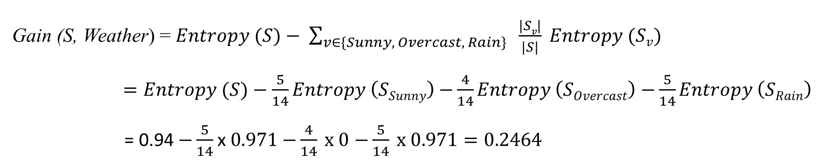
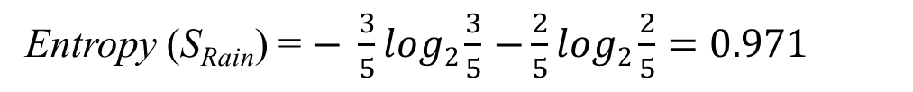
Attributes: Weather
Values (Weather) = Sunny, Overcast, Rain
S = [+9, -5]
Entropy (S) = $− \frac{9}{14}log2\frac{9}{14}$ $−\frac{5}{14}log2\frac{5}{14}=0.94$
Entropy (S_{Sunny}) = $− \frac{2}{5}log2\frac{2}{5}$ $−\frac{3}{5}log2\frac{3}{5}=0.971$
S_{Sunny} = [+2, -3]
Entropy (S_{Overcast}) = $− \frac{4}{4}log2\frac{4}{4}$ $−\frac{0}{4}log2\frac{0}{4}=0$
S_{Overcast} = [+4, -0]
Entropy (S_{Rain}) = $− \frac{3}{5}log2\frac{3}{5}$ $−\frac{2}{5}log2\frac{2}{5}=0.971$
S_{Rain} = [+3, -2]
Gain (S, Weather) = $Entropy (S)− \sum_{v∈\{Sunny, Overcast, Rain\}}{ \frac{|Sv|}{|S|} Entropy (Sv)}$
$=Entropy (S)−\frac{5}{14}Entropy \left(SSunny\right)$ $−\frac{4}{14}Entropy \left(SOvercast\right)$ $−\frac{5}{14}Entropy \left(SRain\right)$
= 0.94 $−\frac{5}{14}$ x $0.971$ $−\frac{4}{14} x 0$ $−\frac{5}{14} x 0.971=0.2464$

Slide 11
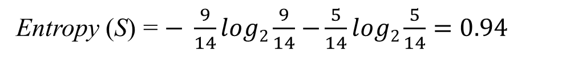
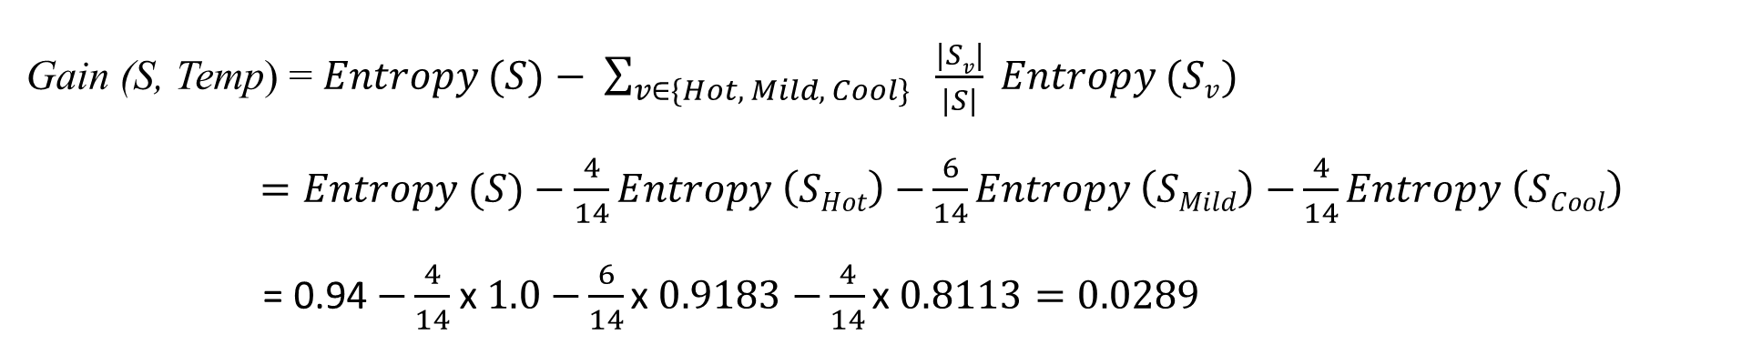
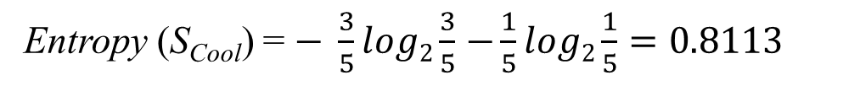
Attributes: Temp
Values (Temp) = Hot, Mild, Cool
S = [+9, -5]
Entropy (S) = $− \frac{9}{14}log2\frac{9}{14}$ $−\frac{5}{14}log2\frac{5}{14}=0.94$
Entropy (S_{Hot}) = $− \frac{2}{4}log2\frac{2}{4}$ $−\frac{2}{4}log2\frac{2}{4}=1.0$
S_{Hot} = [+2, -2]
Entropy (S_{Mild}) = $− \frac{4}{6}log2\frac{4}{6}$ $−\frac{2}{6}log2\frac{2}{6}=0.9183$
S_{Mild} = [+4, -2]
Entropy (S_{Cool}) = $− \frac{3}{5}log2\frac{3}{5}$ $−\frac{1}{5}log2\frac{1}{5}=0.8113$
S_{Cool} = [+3, -1]
Gain (S, Temp) = $Entropy (S)− \sum_{v∈\{Hot, Mild, Cool\}}{ \frac{|Sv|}{|S|} Entropy (Sv)}$
$=Entropy (S)−\frac{4}{14}Entropy \left(SHot\right)$ $−\frac{6}{14}Entropy \left(SMild\right)$ $−\frac{4}{14}Entropy \left(SCool\right)$
= 0.94 $−\frac{4}{14}$ x $1.0$ $−\frac{6}{14}\text{x} 0.9183$ $−\frac{4}{14}\text{x} 0.8113=0.0289$

Slide 12
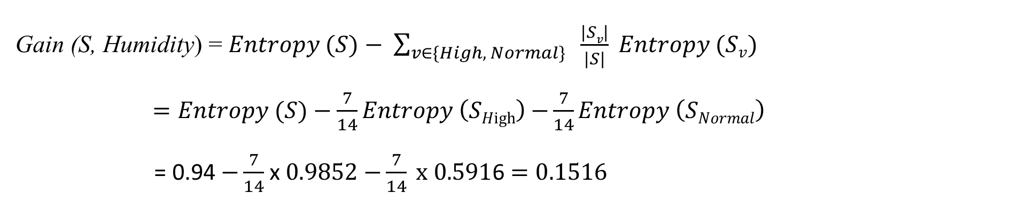
Attributes: Humidity
Values (Humidity) = High, Normal
S = [+9, -5]
Entropy (S) = $− \frac{9}{14}log2\frac{9}{14}$ $−\frac{5}{14}log2\frac{5}{14}=0.94$
Entropy (S_{High}) = $− \frac{3}{7}log2\frac{3}{7}$ $−\frac{4}{7}log2\frac{4}{7}=0.9852$
S_{High} = [+3, -4]
Entropy (S_{Normal} = $− \frac{6}{7}log2\frac{6}{7}−\frac{1}{7}log2\frac{1}{7}=0.5916$
S_{Normal} = [+6, -1]
Gain (S, Humidity) = $Entropy (S)− \sum_{v∈\{High, Normal\}}{ \frac{|Sv|}{|S|} Entropy (Sv)}$
$=Entropy (S)−\frac{7}{14}Entropy \left(SHigh\right)$ $−\frac{7}{14}Entropy \left(SNormal\right)$
= 0.94 $−\frac{7}{14}$ x $0.9852$ $−\frac{7}{14} x 0.591$6 $=0.1516$

Slide 13
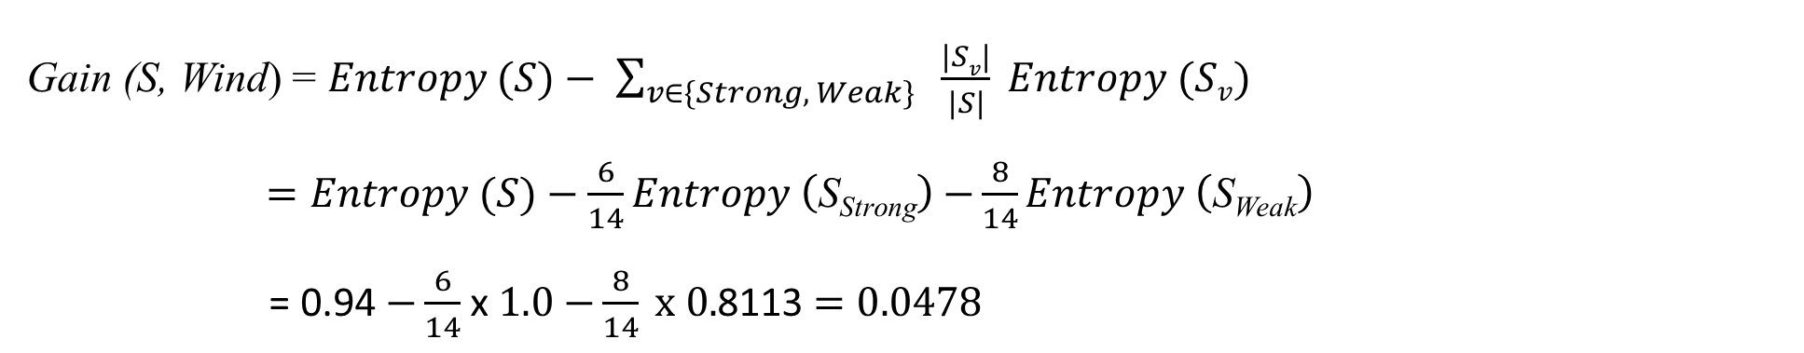
Attributes: Wind
Values (Wind) = Strong, Weak
S = [+9, -5]
Entropy (S) = $− \frac{9}{14}log2\frac{9}{14}$ $−\frac{5}{14}log2\frac{5}{14}=0.94$
Entropy (S_{Strong}) = $− \frac{3}{6}log2\frac{3}{6}$ $−\frac{3}{6}log2\frac{3}{6}=1.0$
S_{Strong} = [+3, -3]
Entropy (S_{Weak}) = $− \frac{6}{8}log2\frac{6}{8}−\frac{2}{8}log2\frac{2}{8}=0.8113$
S_{Weak} = [+6, -2]
Gain (S, Wind) = $Entropy (S)− \sum_{v∈\{Strong, Weak\}}{ \frac{|Sv|}{|S|} Entropy (Sv)}$
$=Entropy (S)−\frac{6}{14}Entropy \left(\text{S}\text{Strong}\right)$ $−\frac{8}{14}Entropy \left(\text{S}\text{Weak}\right)$
= 0.94 $−\frac{6}{14}$ x $1.0$ $−\frac{8}{14} x 0.$8113 $=0.0478$

Slide 14
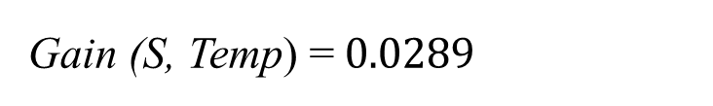
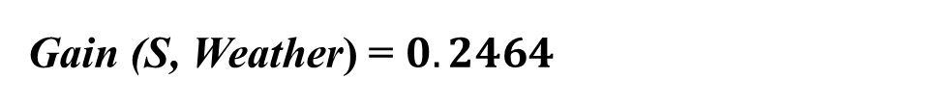
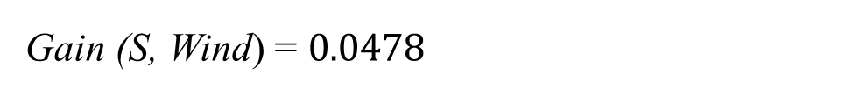
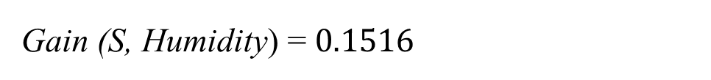
Gain (S, Weather) = $0.2464$
Gain (S, Temp) =$0.0289$
Gain (S, Humidity) = $0.1516$
Gain (S, Wind) = $0.0478$

Slide 15
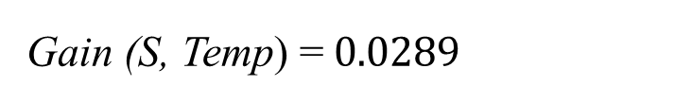
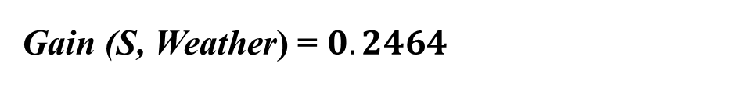
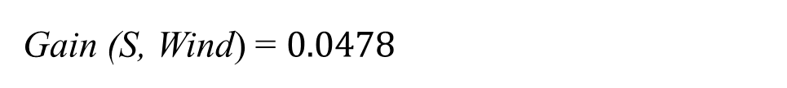
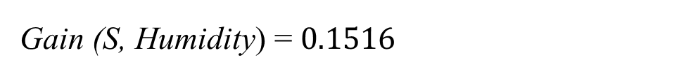
[+9, -5]
Gain (S, Weather) = $0.2464$
Weather
[+2, -3]
[+3, -2]
Gain (S, Temp) =$0.0289$
[+4, -0]
Gain (S, Humidity) = $0.1516$
Sunny
Overcast
Rain
Gain (S, Wind) = $0.0478$
?
?
Yes

Slide 16
Weather: Sunny
Day | Temp | Humidity | Wind | Play Tennis
Day 1 | Hot | High | Weak | No
Day 2 | Hot | High | Strong | No
Day 8 | Mild | High | Weak | No
Day 9 | Cool | Normal | Weak | Yes
Day 11 | Mild | Normal | Strong | Yes

Slide 17
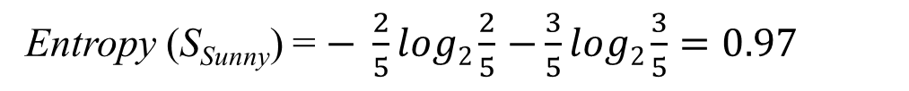
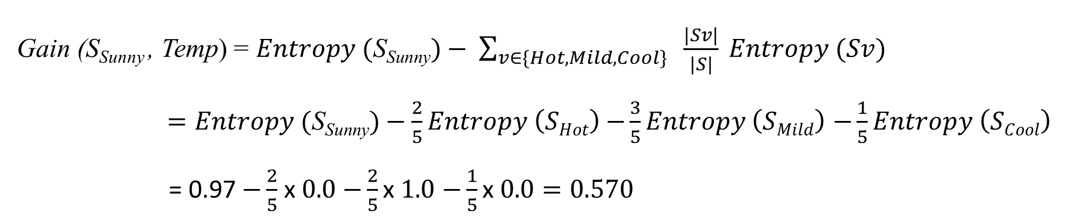
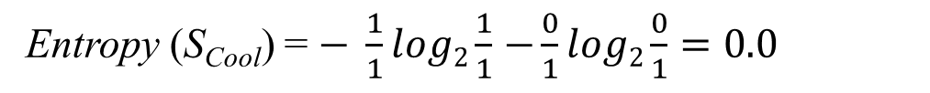
Attributes: Temp
Values (Temp) = Hot, Mild, Cool
S_{Sunny} = [+2, -3]
Entropy (S_{Sunny}) = $− \frac{2}{5}log2\frac{2}{5}$ $−\frac{3}{5}log2\frac{3}{5}=0.97$
Entropy (S_{Hot}) = $− \frac{0}{2}log2\frac{0}{2}$ $−\frac{2}{2}log2\frac{2}{2}=0.0$
S_{Hot} = [+0, -2]
Entropy (S_{Mild}) = $− \frac{1}{2}log2\frac{1}{2}$ $−\frac{1}{2}log2\frac{1}{2}=1.0$
S_{Mild} = [+1, -1]
Entropy (S_{Cool}) = $− \frac{1}{1}log2\frac{1}{1}$ $−\frac{0}{1}log2\frac{0}{1}=0.0$
S_{Cool} = [+1, -0]
Gain (S_{Sunny} , Temp) = $Entropy (\text{S}\text{Sunny})− \sum_{v∈\{Hot, Mild, Cool\}}{ \frac{|Sv|}{|S|} Entropy (Sv)}$
$=Entropy (\text{S}\text{Sunny})−\frac{2}{5}Entropy \left(SHot\right)$ $−\frac{3}{5}Entropy \left(SMild\right)$ $−\frac{1}{5}Entropy \left(SCool\right)$
= 0.97 $−\frac{2}{5}$ x $0.0$ $−\frac{2}{5}\text{x} 1.0$ $−\frac{1}{5}\text{x} 0.0=0.570$

Slide 18
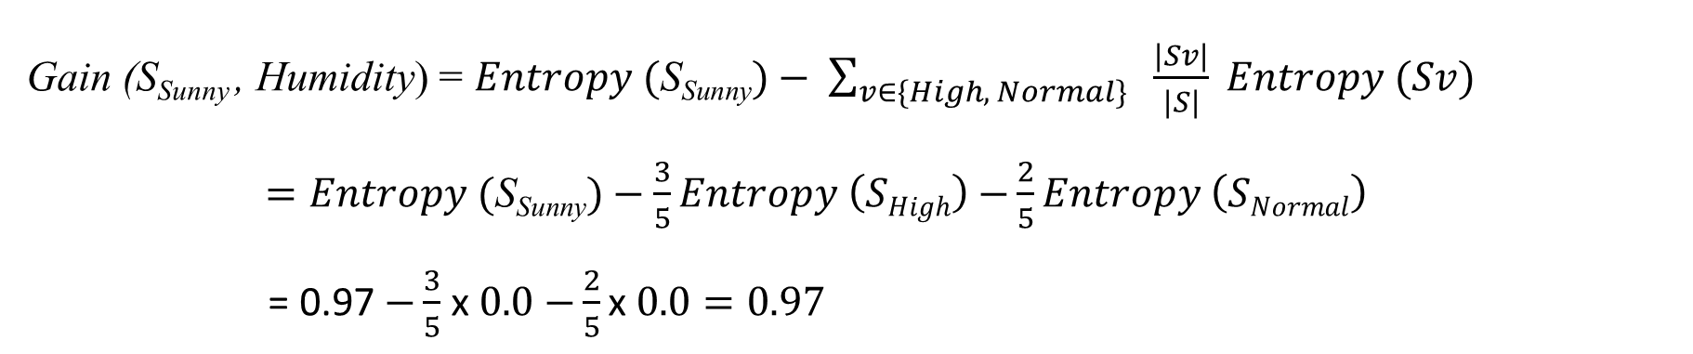
Attributes: Humidity
Values (Humidity) = High, Normal
S_{Sunny} = [+2, -3]
Entropy (S_{Sunny}) = $− \frac{2}{5}log2\frac{2}{5}$ $−\frac{3}{5}log2\frac{3}{5}=0.97$
Entropy (S_{High}) = $− \frac{0}{3}log2\frac{0}{3}$ $−\frac{3}{3}log2\frac{3}{3}=0.0$
S_{High} = [+0, -3]
Entropy (S_{Normal}) = $− \frac{2}{2}log2\frac{2}{2}$ $−\frac{0}{2}log2\frac{0}{2}=0.0$
S_{Normal} = [+2, -0]
Gain (S_{Sunny} , Humidity) = $Entropy (\text{S}\text{Sunny})− \sum_{v∈\{High, Normal\}}{ \frac{|Sv|}{|S|} Entropy (Sv)}$
$=Entropy (\text{S}\text{Sunny})−\frac{3}{5}Entropy \left(SHigh\right)$ $−\frac{2}{5}Entropy \left(SNormal\right)$
= 0.97 $−\frac{3}{5}$ x $0.0$ $−\frac{2}{5}\text{x} 0.0=0.97$

Slide 19
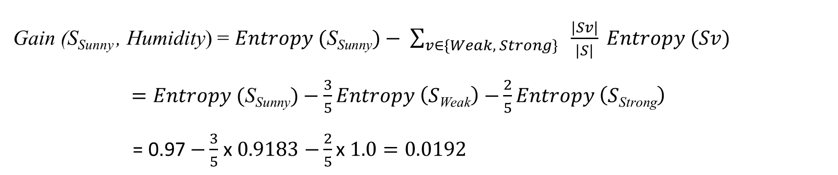
Attributes: Wind
Values (Wind) = Weak, Strong
S_{Sunny} = [+2, -3]
Entropy (S_{Sunny}) = $− \frac{2}{5}log2\frac{2}{5}$ $−\frac{3}{5}log2\frac{3}{5}=0.97$
Entropy (S_{Weak}) = $− \frac{1}{3}log2\frac{1}{3}$ $−\frac{2}{3}log2\frac{2}{3}=0.9183$
S_{Weak} = [+1, -2]
Entropy (S_{Strong}) = $− \frac{1}{2}log2\frac{1}{2}$ $−\frac{1}{2}log2\frac{1}{2}=1.0$
S_{Strong} = [+1, -1]
Gain (S_{Sunny} , Humidity) = $Entropy (\text{S}\text{Sunny})− \sum_{v∈\{Weak, Strong\}}{ \frac{|Sv|}{|S|} Entropy (Sv)}$
$=Entropy (\text{S}\text{Sunny})−\frac{3}{5}Entropy \left(S\text{Weak}\right)$ $−\frac{2}{5}Entropy \left(S\text{Strong}\right)$
= 0.97 $−\frac{3}{5}$ x $0.9183$ $−\frac{2}{5}\text{x} 1.0=0.0192$

Slide 20
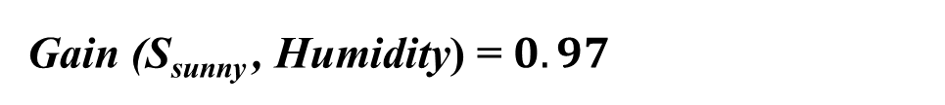
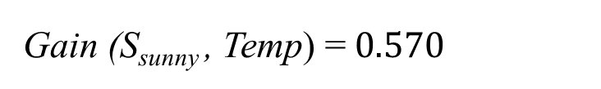
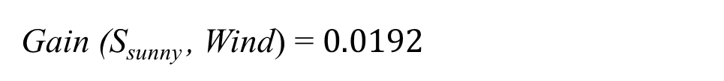
Day | Temp | Humidity | Wind | Play Tennis
Day 1 | Hot | High | Weak | No
Day 2 | Hot | High | Strong | No
Day 8 | Mild | High | Weak | No
Day 9 | Cool | Normal | Weak | Yes
Day 11 | Mild | Normal | Strong | Yes
Gain (S_{sunny} , Temp) =$0.570$
Gain (S_{sunny} , Humidity) = $0.97$
Gain (S_{sunny} , Wind) = $0.0192$

Slide 21
Day | Temp | Humidity | Wind | Play Tennis
Day 1 | Hot | High | Weak | No
Day 2 | Hot | High | Strong | No
Day 8 | Mild | High | Weak | No
Day 9 | Cool | Normal | Weak | Yes
Day 11 | Mild | Normal | Strong | Yes
[+9, -5]
Weather
[+2, -3]
[+3, -2]
[+4, -0]
Sunny
Overcast
Rain
Humidity
Yes
High
Normal
No
Yes

Slide 22
Example: ID3 Algorithm
Day | Temp | Humidity | Wind | Play Tennis
Day 4 | Mild | High | Weak | Yes
Day 5 | Cool | Normal | Weak | Yes
Day 6 | Cool | Normal | Strong | No
Day 10 | Mild | Normal | Weak | Yes
Day 14 | Mild | High | Strong | No

Slide 23
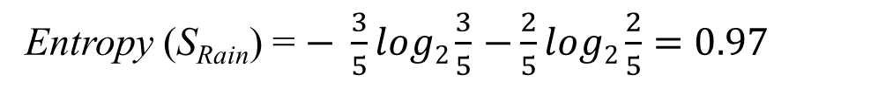
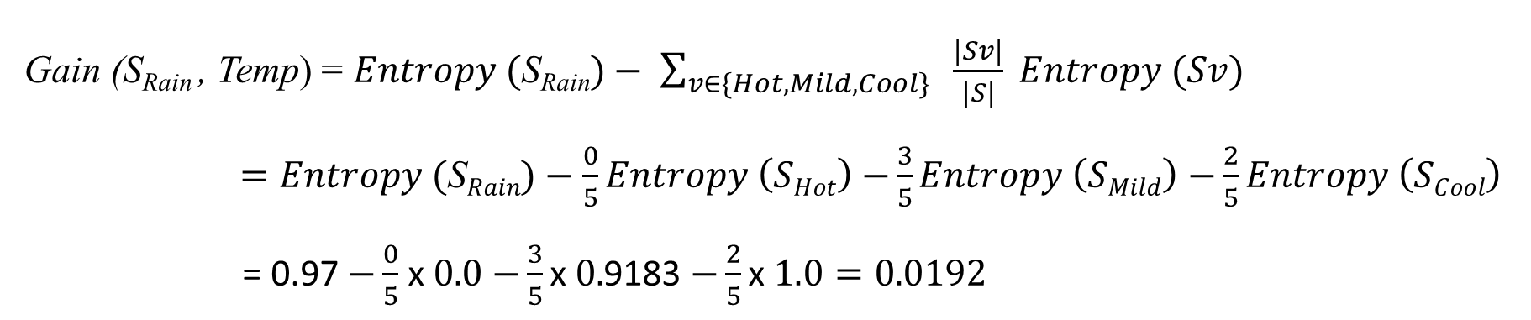
Attributes: Temp
Values (Temp) = Hot, Mild, Cool
S_{Rain} = [+3, -2]
Entropy (S_{Rain}) = $− \frac{3}{5}log2\frac{3}{5}$ $−\frac{2}{5}log2\frac{2}{5}=0.97$
Entropy (S_{Hot}) = $0.0$
S_{Hot} = [+0, -0]
Entropy (S_{Mild}) = $− \frac{2}{3}log2\frac{2}{3}$ $−\frac{1}{3}log2\frac{1}{3}=0.9183$
S_{Mild} = [+2, -1]
S_{Cool} = [+1, -1]
Entropy (S_{Cool}) = $− \frac{1}{2}log2\frac{1}{2}$ $−\frac{1}{2}log2\frac{1}{2}=1.0$
Gain (S_{Rain} , Temp) = $Entropy (\text{S}\text{Rain})− \sum_{v∈\{Hot, Mild, Cool\}}{ \frac{|Sv|}{|S|} Entropy (Sv)}$
$=Entropy (\text{S}Rain)−\frac{0}{5}Entropy \left(SHot\right)$ $−\frac{3}{5}Entropy \left(SMild\right)$ $−\frac{2}{5}Entropy \left(SCool\right)$
= 0.97 $−\frac{0}{5}$ x $0.0$ $−\frac{3}{5}\text{x} 0.$9183 $−\frac{2}{5}\text{x} 1.0=0.0192$

Slide 24
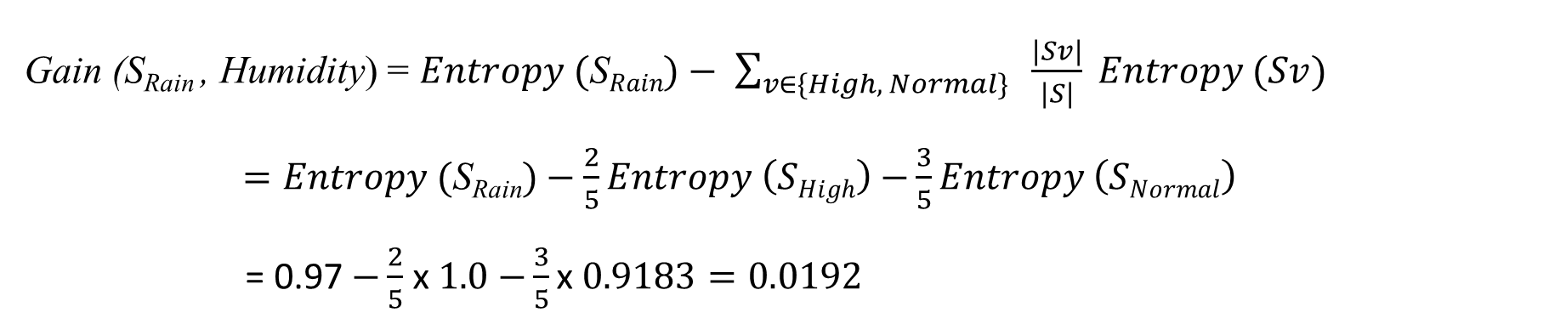
Attributes: Humidity
Values (Humidity) = High, Normal
S_{Rain} = [+3, -2]
Entropy (S_{Rain}) = $− \frac{3}{5}log2\frac{3}{5}$ $−\frac{2}{5}log2\frac{2}{5}=0.97$
Entropy (S_{High}) = $− \frac{1}{2}log2\frac{1}{2}$ $−\frac{1}{2}log2\frac{1}{2}=1.0$
S_{High} = [+1, -1]
Entropy (S_{Normal}) = $− \frac{2}{3}log2\frac{2}{3}$ $−\frac{1}{3}log2\frac{1}{3}=0.9183$
S_{Normal} = [+2, -1]
Gain (S_{Rain} , Humidity) = $Entropy (\text{S}Rain)− \sum_{v∈\{High, Normal\}}{ \frac{|Sv|}{|S|} Entropy (Sv)}$
$=Entropy (\text{S}\text{Rain})−\frac{2}{5}Entropy \left(SHigh\right)$ $−\frac{3}{5}Entropy \left(SNormal\right)$
= 0.97 $−\frac{2}{5}$ x $1.0$ $−\frac{3}{5}\text{x} 0.9183=0.0192$

Slide 25
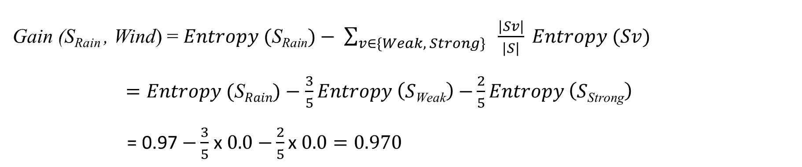
Attributes: Wind
Values (Wind) = Weak, Strong
S_{Rain} = [+3, -2]
Entropy (S_{Rain}) = $− \frac{3}{5}log2\frac{3}{5}$ $−\frac{2}{5}log2\frac{2}{5}=0.97$
Entropy (S_{Weak}) = $− \frac{3}{3}log2\frac{3}{3}$ $−\frac{0}{3}log2\frac{0}{3}=0.0$
S_{Weak} = [+3, -0]
Entropy (S_{Strong}) = $− \frac{0}{2}log2\frac{0}{2}$ $−\frac{2}{2}log2\frac{2}{2}=0.0$
S_{Strong} = [+0, -2]
Gain (S_{Rain} , Wind) = $Entropy (\text{S}\text{Rain})− \sum_{v∈\{Weak, Strong\}}{ \frac{|Sv|}{|S|} Entropy (Sv)}$
$=Entropy (\text{S}Rain)−\frac{3}{5}Entropy \left(S\text{Weak}\right)$ $−\frac{2}{5}Entropy \left(S\text{Strong}\right)$
= 0.97 $−\frac{3}{5}$ x $0.0$ $−\frac{2}{5}\text{x} 0.0=0.970$

Slide 26
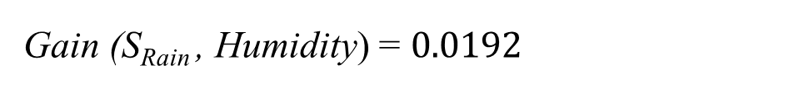
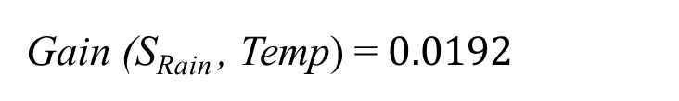
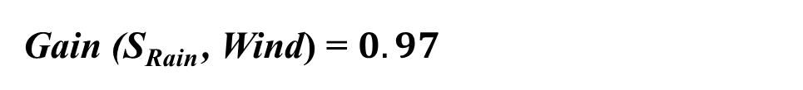
Day | Temp | Humidity | Wind | Play Tennis
Day 4 | Mild | High | Weak | Yes
Day 5 | Cool | Normal | Weak | Yes
Day 6 | Cool | Normal | Strong | No
Day 10 | Mild | Normal | Weak | Yes
Day 14 | Mild | High | Strong | No
Gain (S_{Rain} , Temp) =$0.0192$
Gain (S_{Rain} , Humidity) = $0.0192$
Gain (S_{Rain} , Wind) = $0.97$

Slide 27
Day | Temp | Humidity | Wind | Play Tennis
Day 4 | Mild | High | Weak | Yes
Day 5 | Cool | Normal | Weak | Yes
Day 6 | Cool | Normal | Strong | No
Day 10 | Mild | Normal | Weak | Yes
Day 14 | Mild | High | Strong | No
[+9, -5]
Weather
[+2, -3]
[+3, -2]
[+4, -0]
Sunny
Overcast
Rain
Humidity
Yes
Wind
High
Normal
Weak
Strong
No
Yes
Yes
No

Slide 28
[+9, -5]
Weather
[+2, -3]
[+3, -2]
[+4, -0]
Sunny
Overcast
Rain
Humidity
Yes
Wind
High
Normal
Weak
Strong
No
Yes
Yes
No

